Slide 1

Occlusion and Depth
Notes:
Decisions about how to scale the data inform the context.

Slide 2

By berniedup
Flickr CC
What’s hiding?
Notes:
TREE FOREST IMAGE

Slide 3
Techniques for clutter reduction
Notes:
From Alan and Dix, 2007. A Taxonomy of Clutter Reduction for Information Visualization.
https://core.ac.uk/download/pdf/70210.pdf Assign this paper.

Slide 4
Decrease Point Size

Slide 5
Opacity

Slide 6
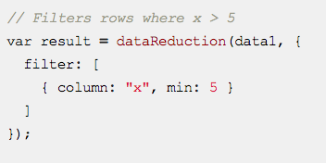
Sampling or Filtering
https://www.npmjs.com/package/data-reduction
Notes:
Sample of the data
Filter takes a subset of the data, on the user side as well - talk more about dimensionality reduction techniques later in the course

Slide 7
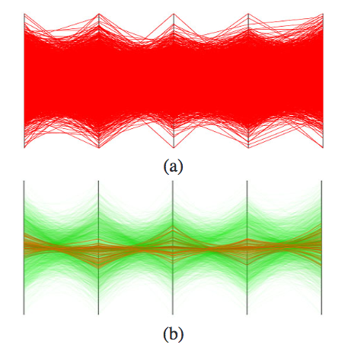
Clustering
Zhou, et al., 2008, Visual clustering in parallel coordinates. In Computer Graphics Forum (Vol. 27, No. 3, pp. 1047-1054).
Notes:
Data centric and also visualization approaches
Previous research: hierarchical clustering data centric method
Optimization of the geometrically grouping polylines while they are plotted

Slide 8
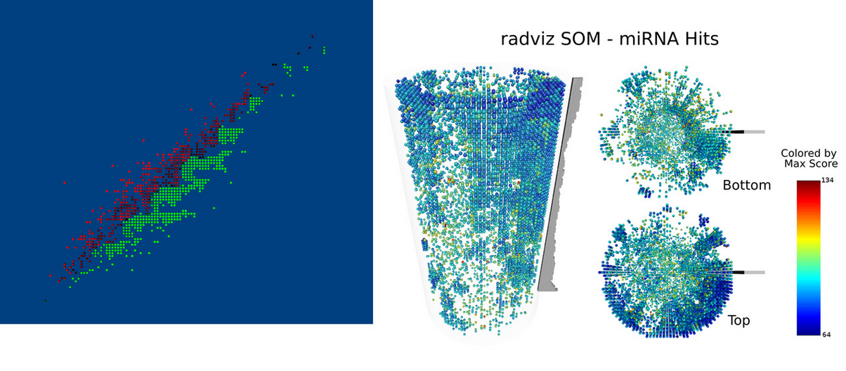
Jittering
Trutschi & Grinstein, 2003. Intelligently resolving point occlusion.
Notes:
Displacement of points of lines,
separartes dots so that they aren't plotted directly on top of each other
Can be random or TRUTSCHI and GRINSTEIN a neural network-based smart jittering algorithm

Slide 9
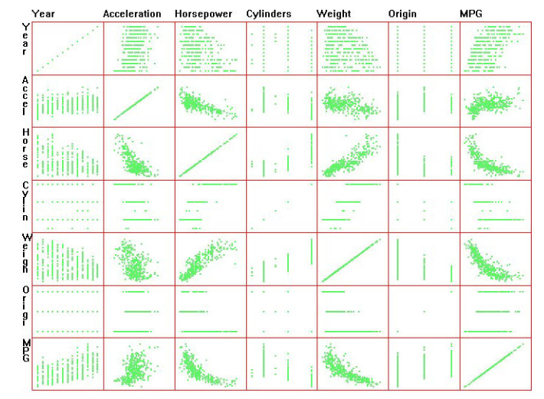
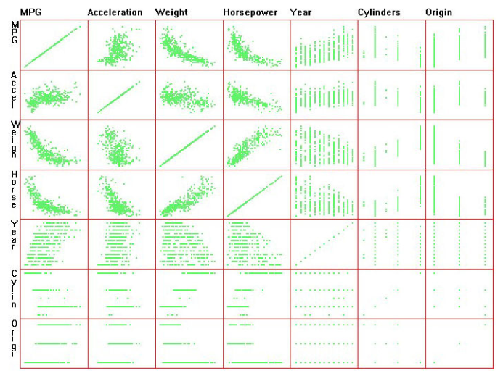
Dimensional Reordering
Peng, Ward, & Rundensteiner, 2004. Clutter reduction in multi-dimensional
data visualization using dimension reordering.
Notes:
Not reducing points necessarily but search
Cars datasets in the first see dimensions that are randomly positioned;
Alogorithms search for a dimension ordering that reduces clutter
Peng has developed algorithms to reorder scatter plot dimensions such that dimensions with similar patterns
Reduce search

Slide 10

Showing Depth
Photo by Ernie Cate
feelgrafix.com
Notes:
How to you create a sense of depth in visualization

Slide 11
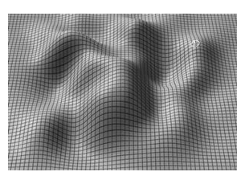
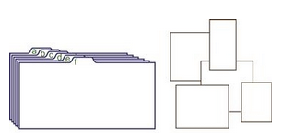
Spatial Depth Cues
Size
Gridlines
Surface shading and texture
Shadows
Ware, 2013. Information Visualization: Perception for Design.
Notes:
Use with caution in vis

Slide 12
3D
ahead
proceed with
CAUTION!

Slide 13
A Hierarchy of Accuracy
Position
Length
Angle, slope
Area
Volume
Color, density
Decreasing quantitative accuracy
Notes:
a hierarchy of accuracy – quantitative, that is position length angle, slope area volume color, density

Slide 14
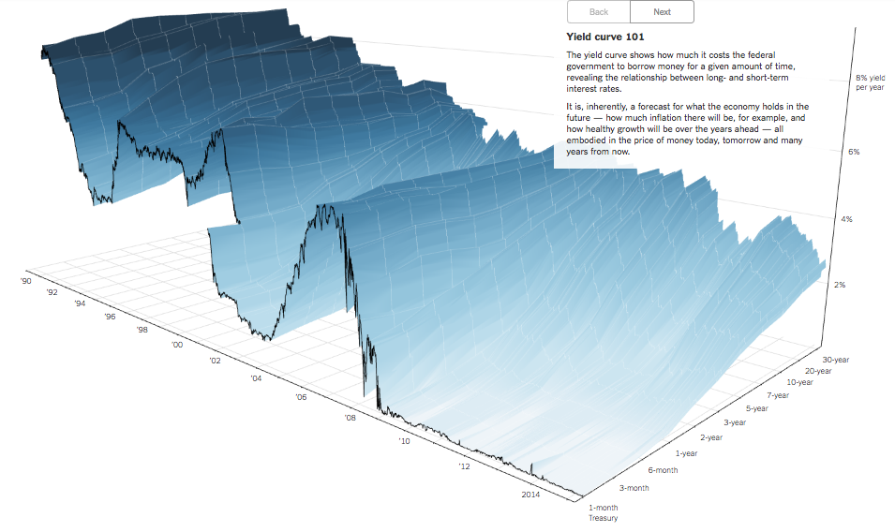
NY Times 3-D Economics View
http://www.nytimes.com/interactive/2015/03/19/upshot/3d-yield-curve-economic-growth.html
Notes:
http://www.nytimes.com/interactive/2015/03/19/upshot/3d-yield-curve-economic-growth.html
Economic growth PERCENT, DATE, PERIODS of time

Slide 15
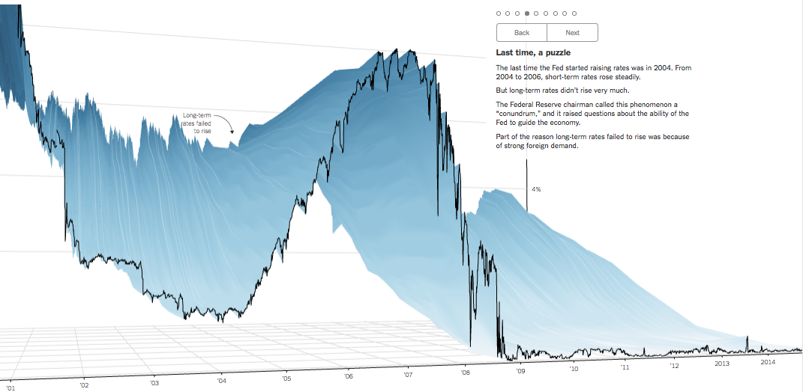

Slide 16


